Slide 1

Using Data Analytics on Dimensionless Numbers to Predict the Ultimate Recovery Factors For Different Drive Mechanisms in Gulf Of Mexico Oil Fields
Thesis Defense
Gowtham Talluru
Fall-2017

Slide 2

Outline
Problem understanding
Earlier data analytical models for predicting RF
Data understanding
Data Preparation/ Feature Engineering
Modeling
Multiple Linear Regression
k Nearest Neighbors
Regression Trees
Random Forest
Artificial Neural Network
Ensemble model
Sensitivity Analysis
Recommendations for future work
Conclusions

Slide 3
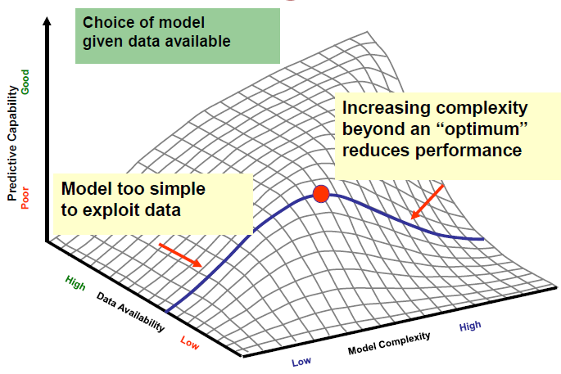
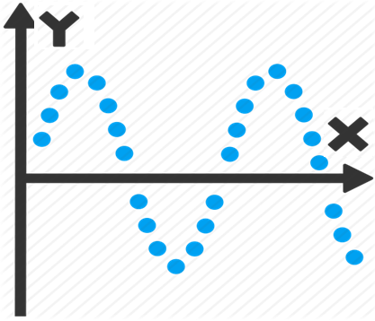
Data, Feature Engineering and Model
Lecture slides Dr. Wu
Notes:
The three main components
Feature engineering – dependent variable may not have direct relationship with independent variables

Slide 4
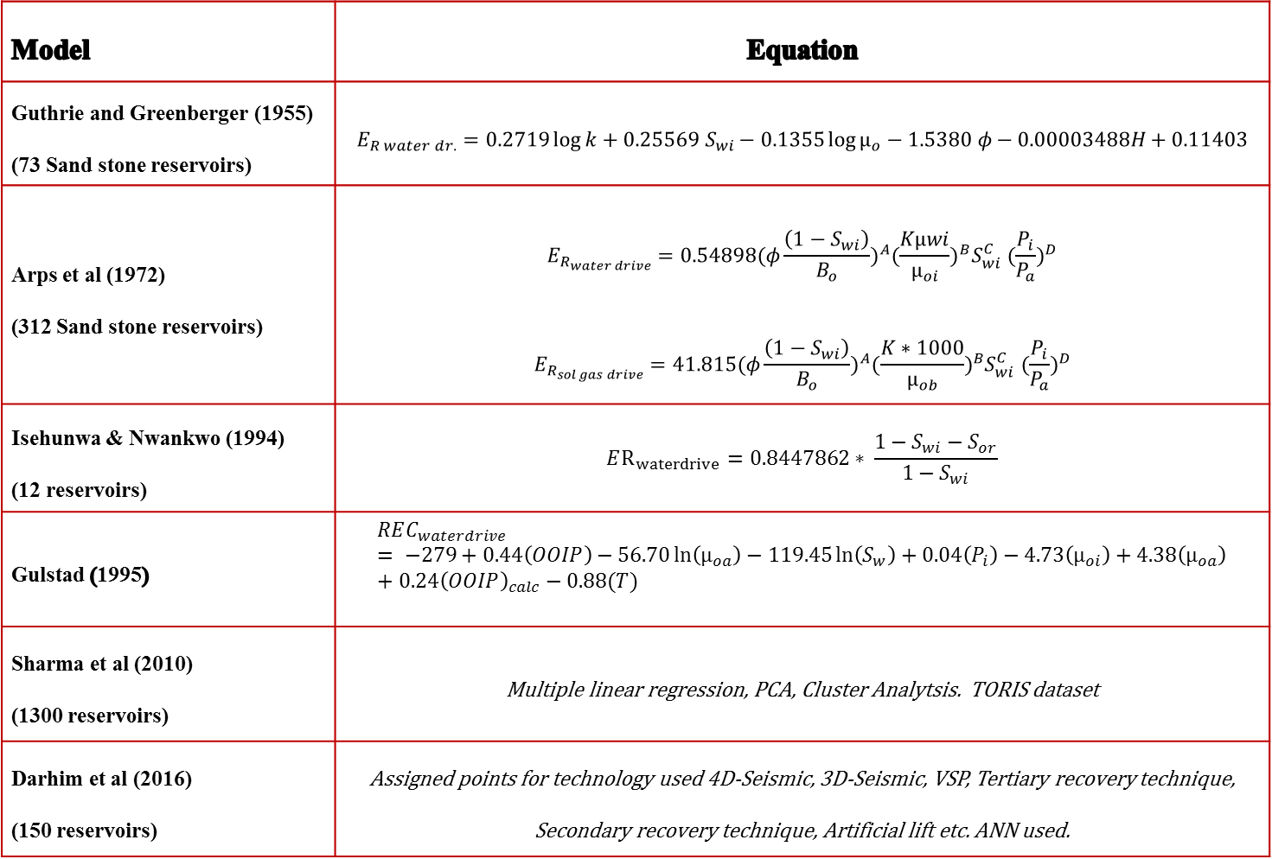
Earlier data analytical models to predict RF
Model | Equation
Guthrie and Greenberger (1955) (73 Sand stone reservoirs) | $$E_{R water dr.}=0.2719\log{k+0.25569 S_{wi}−0.1355\log{µ_{o}−1.5380 φ−0.00003488H+0.11403}}$$
Arps et al (1972) (312 Sand stone reservoirs) | $$E_{R_{water drive}}=0.54898{(φ\frac{\left(1−S_{wi}\right)}{B_{o}})}^{A}{(\frac{Kµwi}{µ_{oi}})}^{B}S_{wi}^{C} {(\frac{P_{i}}{P_{a}})}^{D}$$ $$E_{R_{sol gas drive}}=41.815{(φ\frac{\left(1−S_{wi}\right)}{B_{o}})}^{A}{(\frac{K∗1000}{µ_{ob}})}^{B}S_{wi}^{C} {(\frac{P_{i}}{P_{a}})}^{D}$$
Isehunwa & Nwankwo (1994) (12 reservoirs) | $$ER_{waterdrive}=0.8447862∗ \frac{1−S_{wi}−S_{or}}{1−S_{wi}}$$
Gulstad (1995) | $$REC_{waterdrive}= −279+0.44\left(OOIP\right)−56.70\ln\left(µ_{oa}\right)−119.45\ln\left(S_{w}\right)+0.04\left(P_{i}\right)−4.73\left(µ_{oi}\right)+4.38\left(µ_{oa}\right)+0.24{\left(OOIP\right)}_{calc}−0.88(T)$$
Sharma et al (2010) (1300 reservoirs) | Multiple linear regression, PCA, Cluster Analytsis. TORIS dataset
Darhim et al (2016) (150 reservoirs) | Assigned points for technology used 4D-Seismic, 3D-Seismic, VSP, Tertiary recovery technique, Secondary recovery technique, Artificial lift etc. ANN used.
Notes:
Based on number of reservoirs
First 4 similar are LR models before 1995 while new data analytical models were not widespread
Sharma et al ( divided the RF into categories and classification techniques)

Slide 5
Work Flow
Raw Data
13288 Oil and Gas Reservoirs
82 Attributes
Data Filtering
Remove specific kind of reservoirs with very few data instances
Data processing
Reorganize factor variables to reduce the levels
Select categorical variables which are statistically significant
Remove reservoirs with data errors (ORF, OIP, BHCOMP, k=0 etc)
Select reservoirs which finished 80% of recoverable reserves.
Check reported RF is consistent with calculated RF
Create copies of data and use transformations appropriate for each modelling technique
Split the data into training and test sets
Modelling
Multi linear regression, Robust regression, LASSO
kNN
Decision trees, Random forest
Artificial Neural Networks, Ensemble
Select oil reservoirs
Notes:
Data filtering
Reservoirs without wells- having ORF, zero OIP, zero k, porosity
Reservoirs having few instances( Structure, Timezone)
Reservoirs more than 80% Ultimate
Data Processing
Converting predictors into appropriate data type
Why reorganizing factor variables
Statistical significance of categorical variables

Slide 6
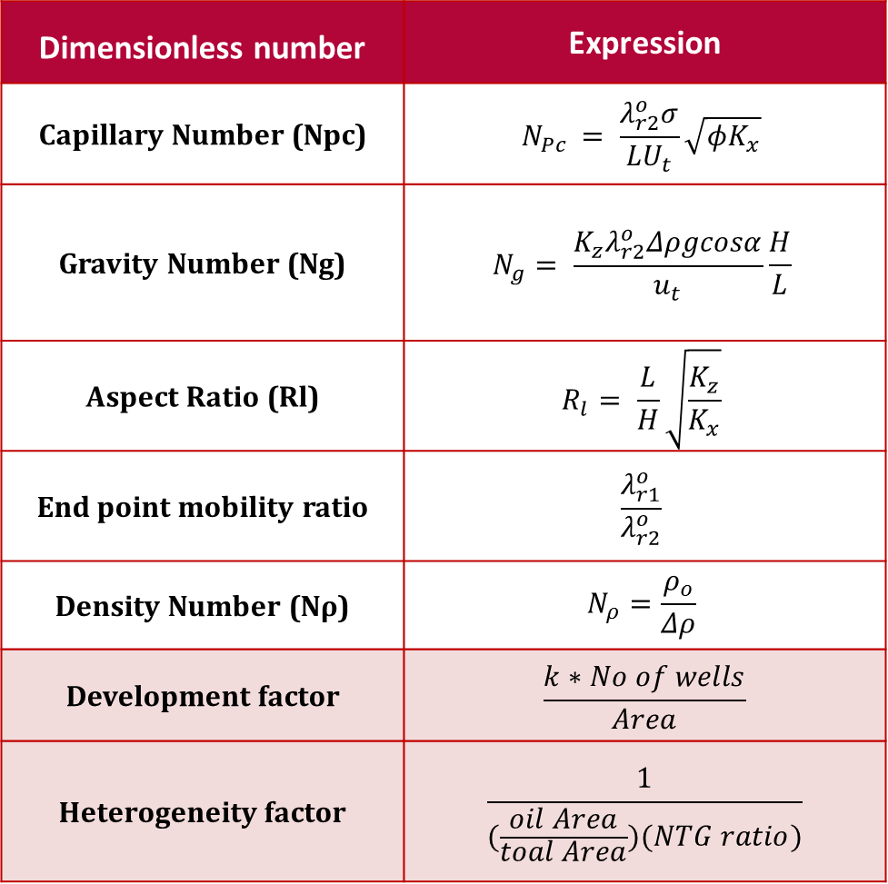
Dimensionless parameters
Dimensionless number | Expression
Capillary Number (Npc) | $$N_{Pc }= \frac{λ_{r2}^{o}σ}{LU_{t}}\sqrt{φK_{x}}$$
Gravity Number (Ng) | $$N_{g}= \frac{K_{z}λ_{r2}^{o}Δρgcosα}{u_{t}}\frac{H}{L}$$
Aspect Ratio (Rl) | $$R_{l}= \frac{L}{H}\sqrt{\frac{K_{z}}{K_{x}}}$$
End point mobility ratio | $$\frac{λ_{r1}^{o}}{λ_{r2}^{o}}$$
Density Number (Nρ) | $$N_{ρ}=\frac{ρ_{o}}{Δρ}$$
Development factor | $$\frac{k∗No of wells}{Area}$$
Heterogeneity factor | $$\frac{1}{(\frac{oil Area}{toal Area})(NTG ratio)}$$
Notes:
A few- Mico level
A few- Macro level
Need to come up – heterogeneity, field development etc
If two reservoirs having similar dimensionless numbers should have similar recovery factors irrespective of their size and fluid properties
Baker and Swerdloff 1955--- interfacital tension

Slide 7

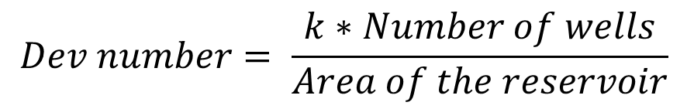
Development Number
$$Dev number= \frac{k∗Number of wells}{Area of the reservoir}$$
$$Dev number=\frac{{\left[L\right]}^{2}∗Dimensionless}{{\left[L\right]}^{2}}$$
Number of wells Dev number
k Dev number
Area Dev number
Notes:
Defined to characterize field development
Dimensionless
Same reservoir if Number of well inc
Two reservoris have same number of wells and perm, reservoir having higher area…..

Slide 8
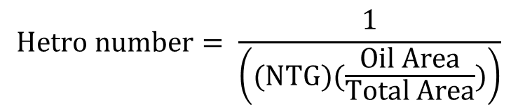
Heterogeneity Number
$$Hetro number= \frac{1}{\left((NTG)(\frac{Oil Area}{Total Area})\right)}$$
NTG | (Oil Area/ Total Area) | Hetro number
1 | 1 | 1
Low | 1 | High
1 | Low | High
Low | Low | Very High
Notes:
We already have methods to characterize heterogeneity
In the data set we didn’t have mu

Slide 9
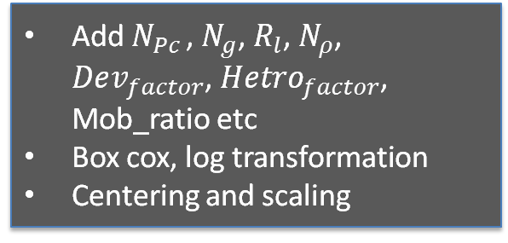
Data processing
raw_data
13288 x 82
oilResClean
3038 x 82
GoM 2524 x 33
Only Complete cases
Only oil Reservoirs (GOR<30)
OIP, ORF, BHCOMP,K ≠ 0
Np > 0.8 * Rec_OIP etc
Data Filtering
Add $N_{Pc }$, $N_{g}$, $R_{l}$, $N_{ρ}$, $Dev_{factor}$, $Hetro_{factor}$, Mob_ratio etc
Box cox, log transformation
Centering and scaling
Adding Dimless numbers and transformation
GoM_train 2022 x 33
GoM_test 2022 x 33
80%
20%

Slide 10
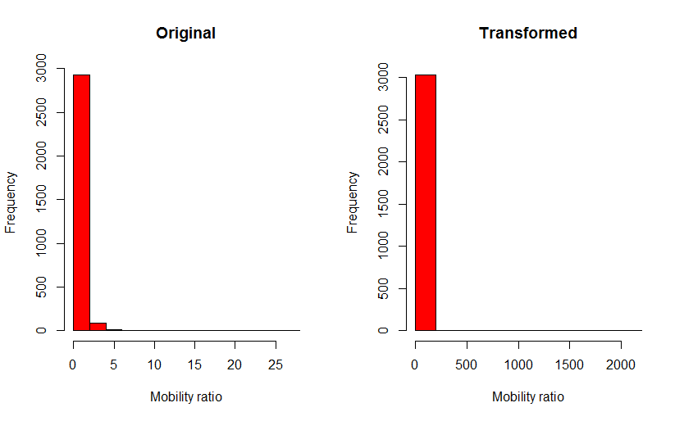
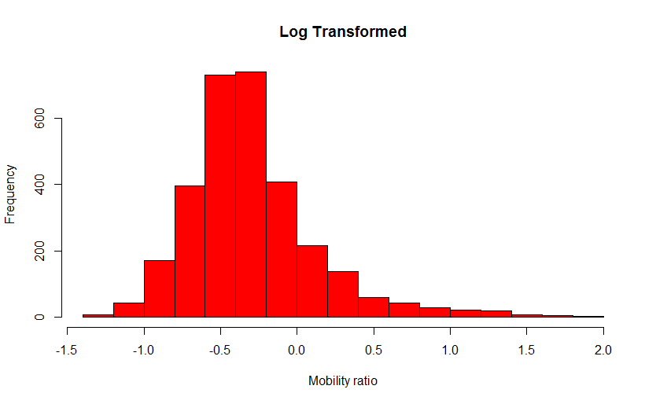

Inspection of each predictor
Summary of End point Mobility Ratio
Min | 1st Quart | Median | Mean | 3rd Quart | Max
0.24 | 0.58 | 0.70 | 0.85 | 0.85 | 27.05
After Removing extreme values (27.05)
And log transformation
$$λ_{boxcox}=−0.76$$
A single extreme value in the data is enough to ruin the data transformation
Notes:
Each predictor had extreme values which can be considered as very different from reservoirs considered for study
Reservoirs with these kind of predictors were removed

Slide 11
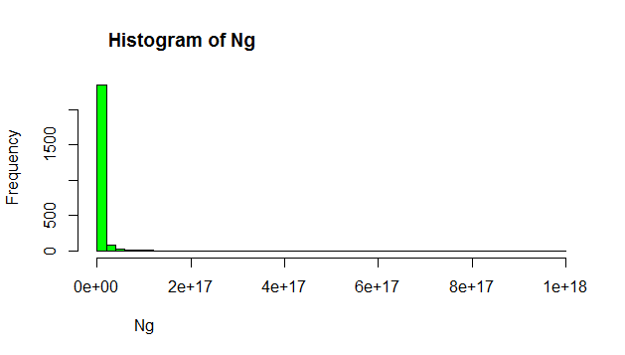
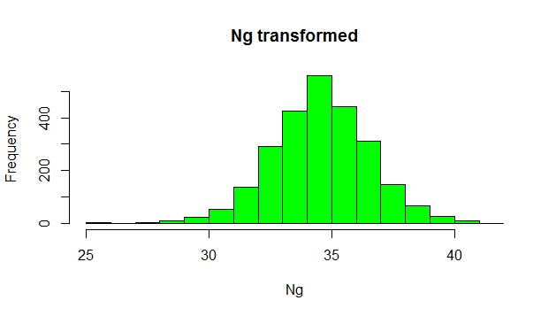
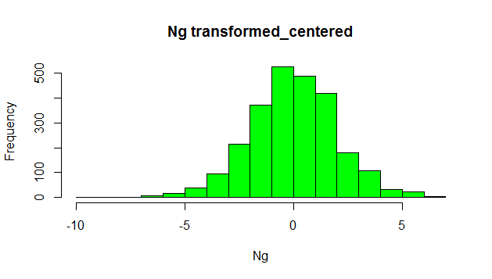

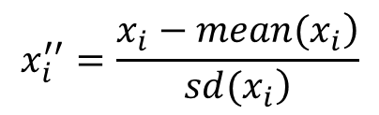
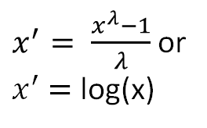
Data transformation
Normal Transformation
$x^{′}= \frac{x^{λ}−1}{λ}$ or
$x^{′}$ $=$ log(x)
Use log transformation if λ ≈0
Centering and Scaling
$$x_{i}^{′′}=\frac{\left.x_{i}−mean(x_{i}\right)}{\left.sd(x_{i}\right)}$$
Notes:
Why data needs to be transformed
Porosity—0.1
Capillary number -10^5
If used in techniques like kNN
MLR doesn’t require normalization but the beta parameters estimated cannot be compared.

Slide 12
Dummy Variables
Reservoir | FSTRU
Res-1 | A
Res-2 | B
Res-3 | C
Res-4 | D
Res-5 | E
Res-6 | K
Reservoir | FSTRU.A | FSTRU.B | FSTRU.C | FSTRU.D | FSTRU.E | FSTRU.K
Res-1 | 1 | 0 | 0 | 0 | 0 | 0
Res-2 | 0 | 1 | 0 | 0 | 0 | 0
Res-3 | 0 | 0 | 1 | 0 | 0 | 0
Res-4 | 0 | 0 | 0 | 1 | 0 | 0
Res-5 | 0 | 0 | 0 | 0 | 1 | 0
Res-6 | 0 | 0 | 0 | 0 | 0 | 1
Notes:
Why dummy vars?
To incorporate factor variables into Regression models

Slide 13
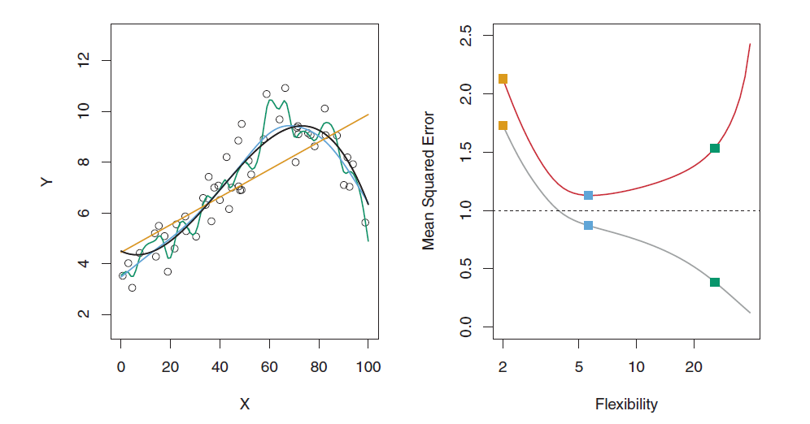
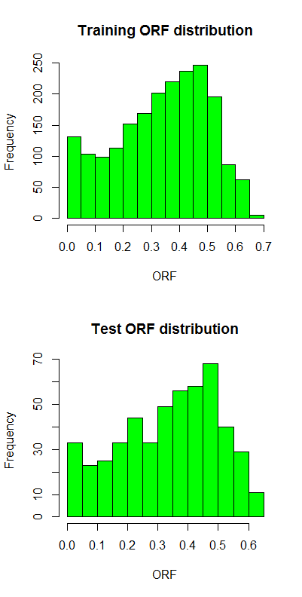
Bias and Variance, Training and Test data sets
Optimum model
Complexity
“Applied predictive modelling, Max Kuhn & K Johnson
80% Train data, 20% Test data
Notes:
Bias is how much the model deviates from original data
Variance is how flexible model is , Weightage to outliers
If we keep increasing the flexibility
So test data set is separated to evaluate models with different bias and variance
While separating test data, the distribution of target variable should be same in both

Slide 14
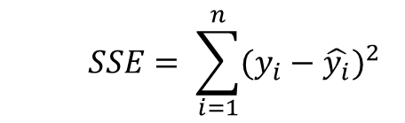
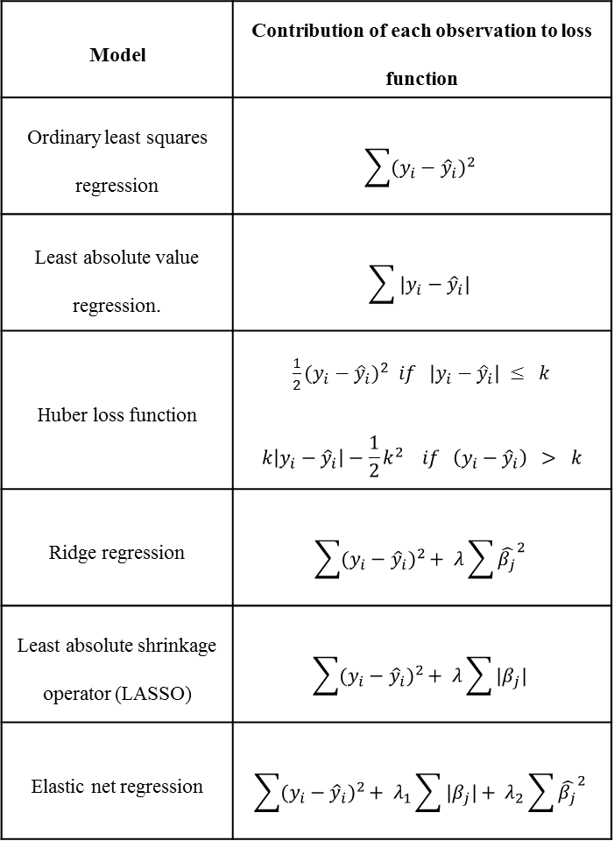
Linear regression and its cousins
Model | Contribution of each observation to loss function
Ordinary least squares regression | $$\sum{{(y_{i}−{\hat{y}}_{i})}^{2}}$$
Least absolute value regression. | $$\sum{|y_{i}−{\hat{y}}_{i}|}$$
Huber loss function | ${\frac{1}{2}(y_{i}−{\hat{y}}_{i})}^{2} if$ $\left|y_{i}−{\hat{y}}_{i}\right| ≤ k$ $$k\left|y_{i}−{\hat{y}}_{i}\right|−\frac{1}{2}k^{2} if \left(y_{i}−{\hat{y}}_{i}\right) > k$$
Ridge regression | $$\sum{{(y_{i}−{\hat{y}}_{i})}^{2}}+ λ\sum{{\hat{β_{j}}}^{2}}$$
Least absolute shrinkage operator (LASSO) | $$\sum{{(y_{i}−{\hat{y}}_{i})}^{2}}+ λ\sum{{|β}_{j}|}$$
Elastic net regression | $$\sum{{(y_{i}−{\hat{y}}_{i})}^{2}}+ λ_{1}\sum{{|β}_{j}|}+ λ_{2}\sum{{\hat{β_{j}}}^{2}}$$
$$y=b_{0}+b_{1}x_{1}+b_{2}x_{2}+b_{3}x_{3}+ . . . . . . . b_{n}x_{n}+e_{i}$$
$$SSE= \sum_{i=1}^{n}{{(y_{i}−\hat{y_{i}})}^{2}}$$
Pros
Easy to interpret
Easy to compare the weightage of predictors
Cons
Non linear interactions
Highly correlated predictors
No bounds on target
Notes:
Various variants of linear regression.
The main difference is definition of error function and balance between bias and variance
OLR has more variance or it gives relatively more importance to extreme points

Slide 15

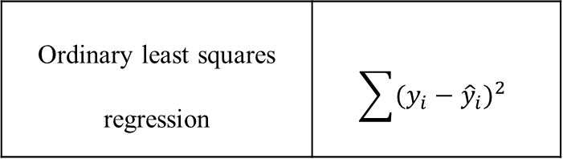



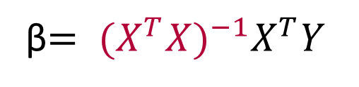
Closed form solution – OLS Regression
Ordinary least squares regression | $$\sum{{(y_{i}−{\hat{y}}_{i})}^{2}}$$
$Y=$X β + ε
$$ε=Y −Xβ$$
ε$ε^{′ }= {\left(Y−Xβ\right)}^{′}(Y−Xβ)$
$\frac{d}{dβ} \left({\left(Y−Xβ\right)}^{′}\left(Y−Xβ\right)\right)=−2X^{′}(Y−Xβ)$
β$= {(X^{T}X)}^{−1}X^{T}Y$
High Correlation between predictors
No. of predictors greater than No. of observations.

Slide 16
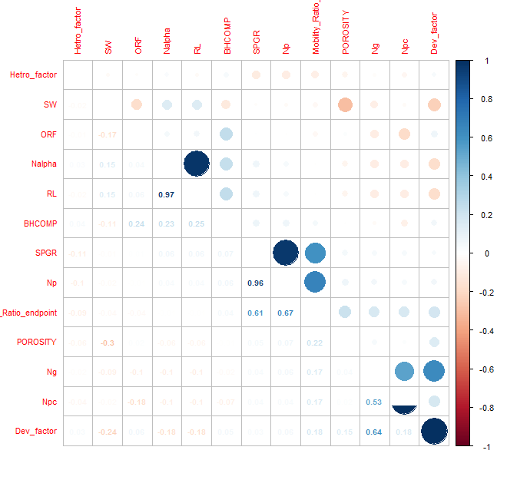
Removing highly correlated predictors
Notes:
Specific gravity and density number
Dip number and Effective aspect ratio

Slide 17
Modelling- Multiple linear Regression
Beta Coefficients of numeric predictors
Beta Coefficients of dummy categorical predictors
Numeric Predictor | Beta
Intercept | 0.368
Porosity | -0.008
End point mobility ratio | 0.030
Nalpha | -0.076
Ng | -0.181
Npc | -0.068
Dev_factor | 0.145
Hetro_factor | -0.016
Categorical Predictor | Beta
FSTRU.A | -0.019
FSTRU.B | -0.039
Play_type.A1 | 0.028
Play_type.F1 | -0.033
DRIVE.COM | -0.015
DRIVE.DEP | -0.044
RES_TYPE.N | 0.021
Out of 31 predictors
FSTRU.A - Anticline
FSTRU.B - Fault
DRIVE.COM – Combination drive
DRIVE.DEP – Depletion drive
DRIVE.WTR – Water drive (Base case)
Root mean square error (RMSE) | 9%
Mean absolute error (MAE) | 7%
Notes:
Beta coefficients of highly significant predictors

Slide 18
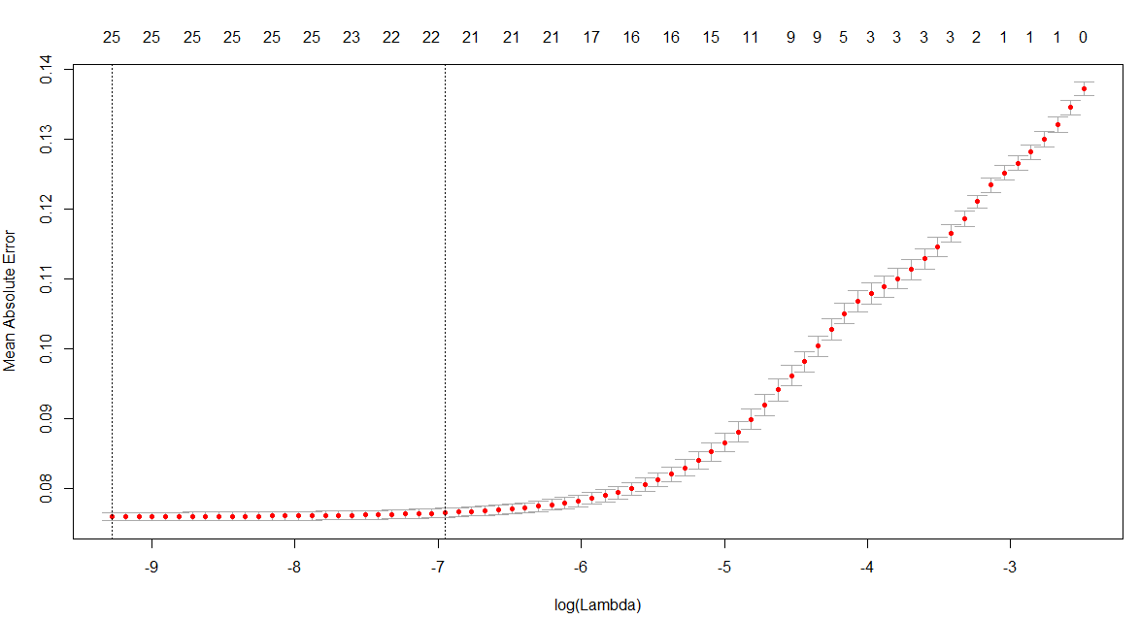
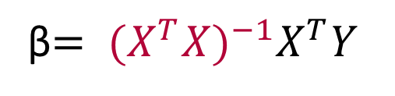
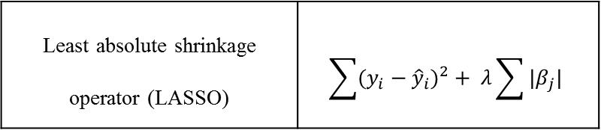
LASSO
Least absolute shrinkage operator (LASSO) | $$\sum{{(y_{i}−{\hat{y}}_{i})}^{2}}+ λ\sum{{|β}_{j}|}$$
β$= {(X^{T}X)}^{−1}X^{T}Y$
No. of non negative beta coefficients
Mean Absolute Error
Log(λ)
Notes:
Do we need 31 predictors?
If we have highly collinear predictors
LASSO acts somewhat similar to PCA to reduce the dimensionality
If lambda increases beta coefficients of irrelevant predictors reduces to zero.

Slide 19
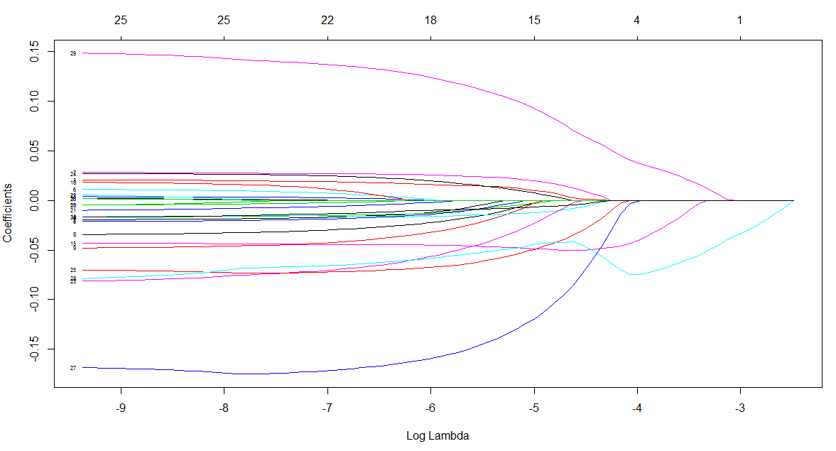
LASSO
No. of non negative predictors
Co efficient
Log(λ)

Slide 20
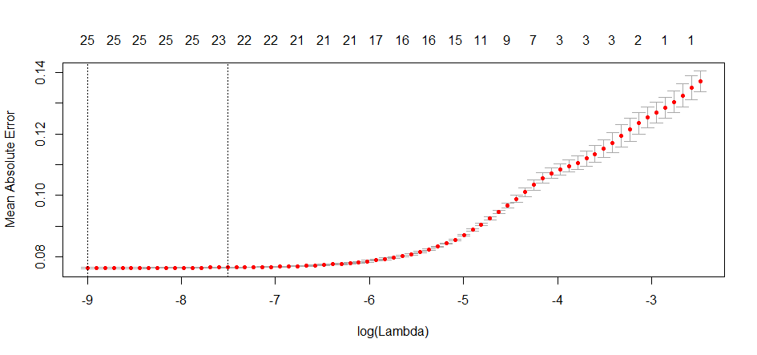
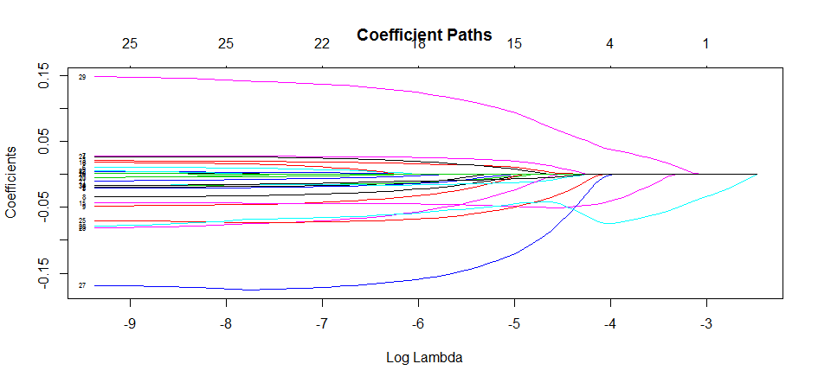
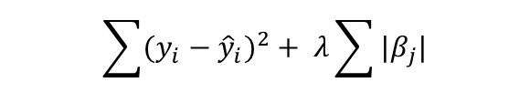
LASSO
$$\sum{{(y_{i}−{\hat{y}}_{i})}^{2}}+ λ\sum{{|β}_{j}|}$$
Coefficient | Value
(Intercept) | 0.346
Dev_factor | 0.071
PLAY_TYPE.A1 | 0.013
FSTRU.C | 0.003
BHCOMP | -0.002
Hetro_factor | -0.005
DRIVE.COM | -0.008
Nalpha | -0.036
Npc | -0.041
DRIVE.DEP | -0.051
Ng | -0.086
No.of Predictors | 11
λ | 0.0098
MAE | 9.5%
RMSE | 11.0%

Slide 21
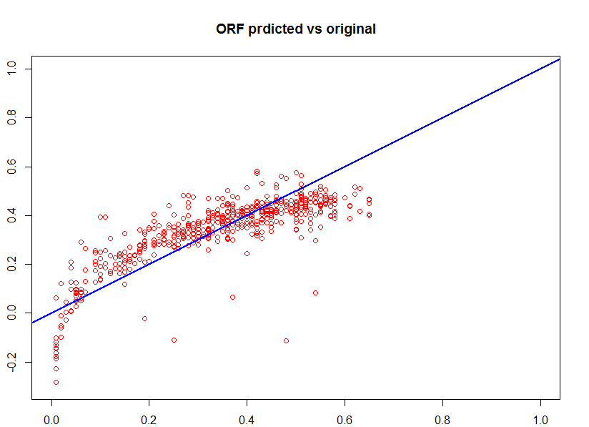
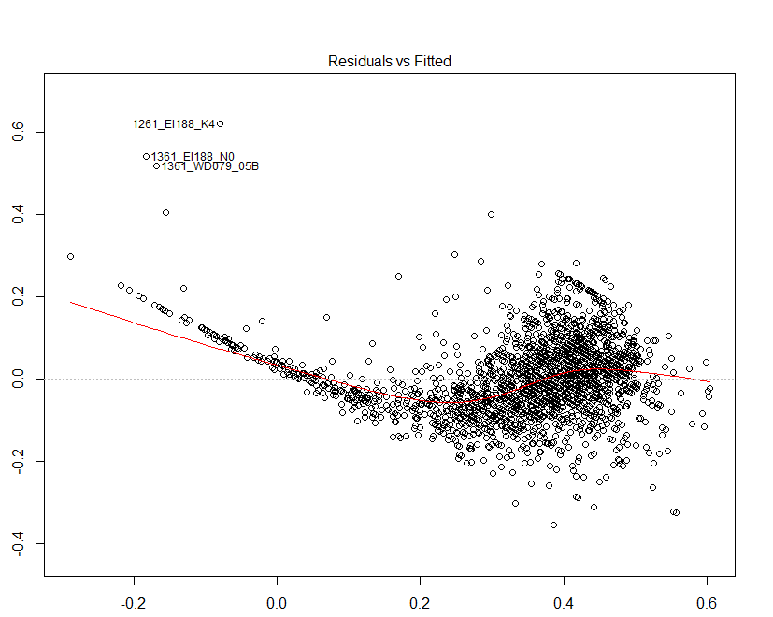
Multiple Linear regression- Predicted vs original ORF
Predicted
Residuals
Negative ORF
Original ORF
Fitted Values
Notes:
Tow issues
Negative ORF
Trend in the residuals indicates presence of non linear interaction

Slide 22
Modelling Non Linear Interactions
Structure of Reservoir :
Density Number
Heterogeneity: Mobility Ratio
Drive : Capillary Number
Structure of Reservoir : Gravity Number
Drive : Gravity Number
FSTRU.E : Density Number
FSTRU.C : Mobility_Ratio_endpoint
DRIVE.DEP : Dev_Number
Dev_factor : Hetro_factor
Ng : Npc
Drive.DEP : Npc
RMSE | 10%
MAE | 7%
Notes:
It is not necessary that each dimless have same effect in every reservoir
Resevoirs with high dip – gravity number
Reservoir with high heterogeneity – mobility ratio

Slide 23
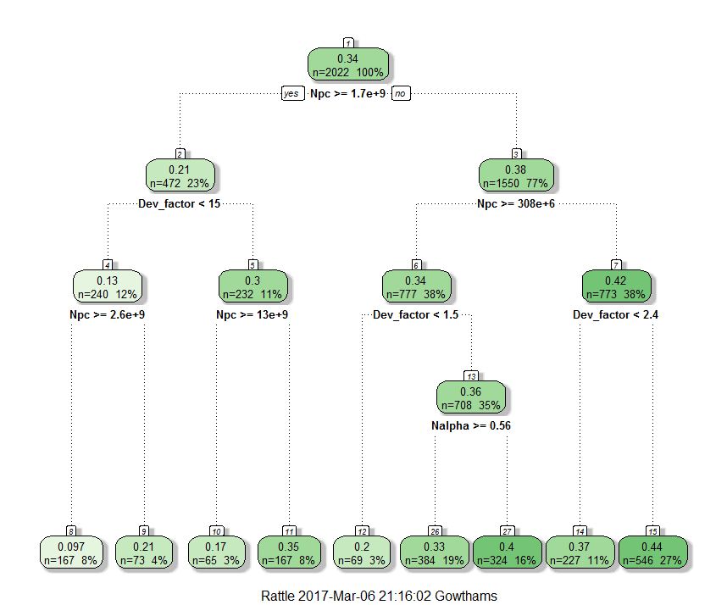
Modelling- Regression trees
Notes:
One way Non linear interactions
Explicitly adding them to model
Another way is models predicting them implicitly
Regression tree splits the data by applying rules on predictors such that the leaf nodes least within sum of squares

Slide 24
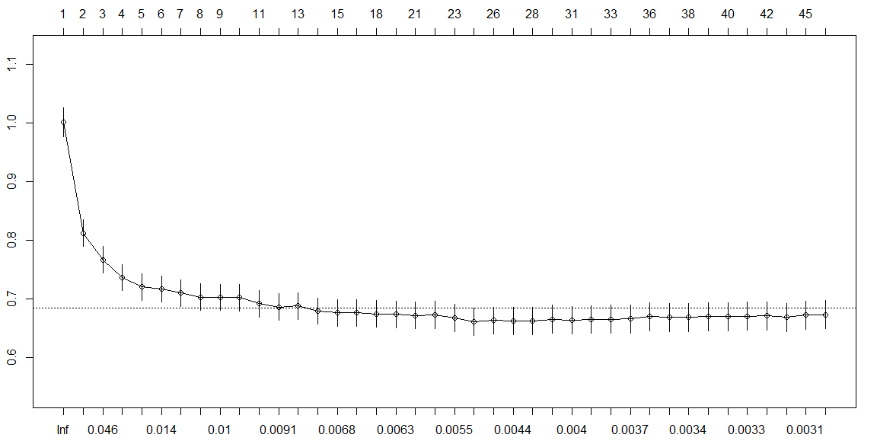
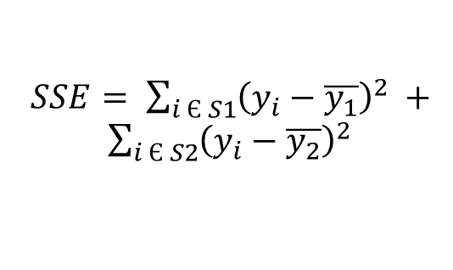

Regression trees size
Tree size
$SSE= \sum_{i Є S1}{{\left(y_{i}−\overline{y_{1}}\right)}^{2}} + \sum_{i Є S2}{{\left(y_{i}−\overline{y_{2}}\right)}^{2}}$
X val relative error
Optimum tree length
Cp
$$C_{p}=\frac{SSE_{n+1}}{SSE_{n}}$$
Notes:
The algorithm will keep splitting the data until the ratio of SSE is greater than Cp
The size of regression tree with low Cp will be high.
To determine the optimum tree size we plot
As the tree size increases error decreases and then increases due to overfitting

Slide 25
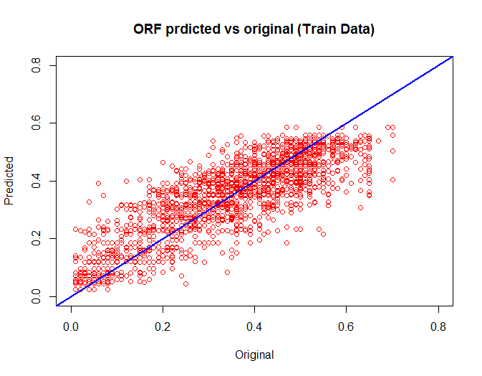
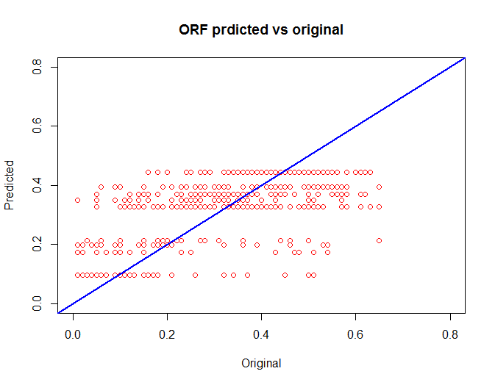
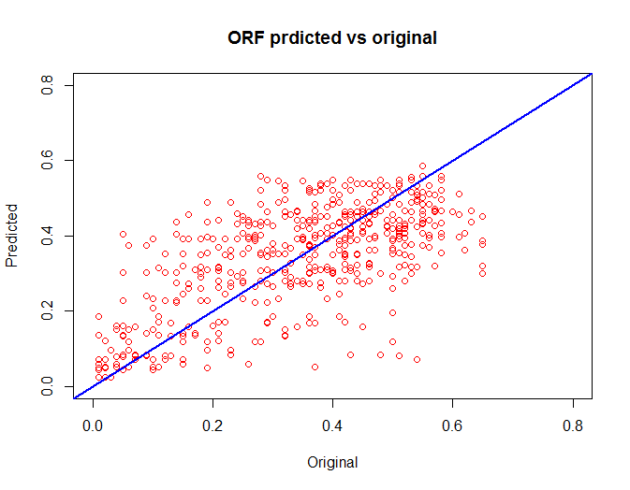
Modelling- Regression trees
Train
Data
Tree Size | 20
Tree Size | 6
Test
Data
RMSE | 13%
MAE | 10%
Notes:
At low tree size, the output has only few levels
As the size of the tree increases---- tends to replicate the original trend

Slide 26
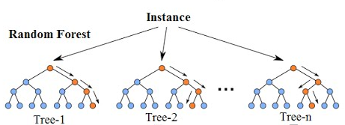
Modelling – Random Forest
Ensemble of many decision trees
Each split in each tree is made upon randomly selected “m” parameters.
m → N Random Forest → Single decision tree
Outcome is average of all the trees
RMSE | 11
MAE | 9
m | 3
No. of Tree | 500
Notes:
Random forest adds flexibility to decision tree

Slide 27
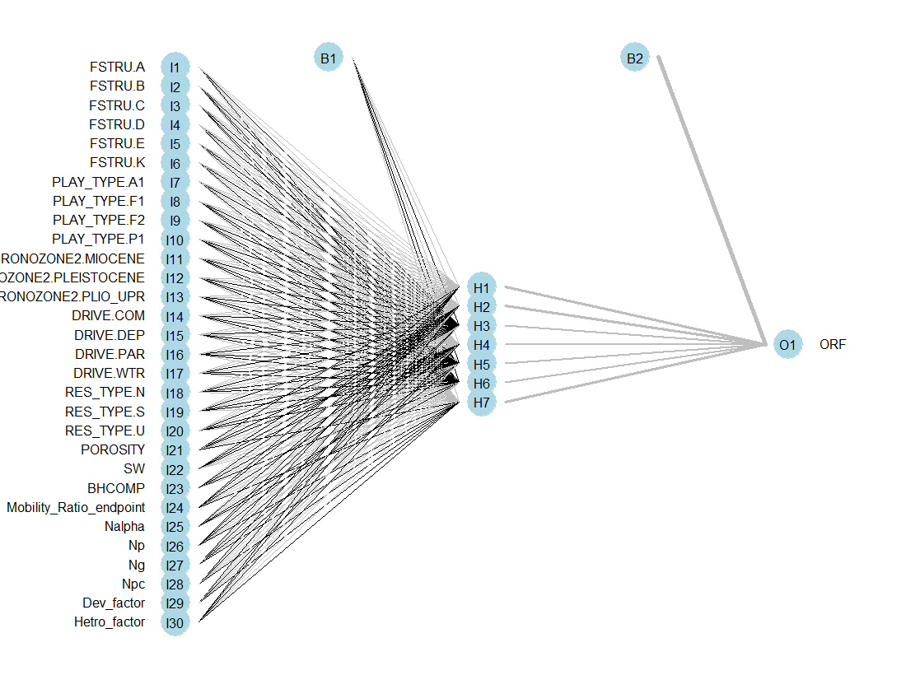
Modelling – Artificial Neural Network
Bias
Predictor
Variables
Target
variable
Hidden
Layer
Hidden
Layer
Notes:
ANN tries to emulate
Inmplicitly predict nonlinear interactions
Each arch has a weitage

Slide 28
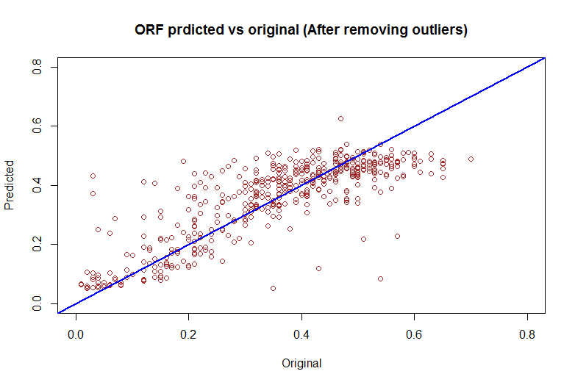
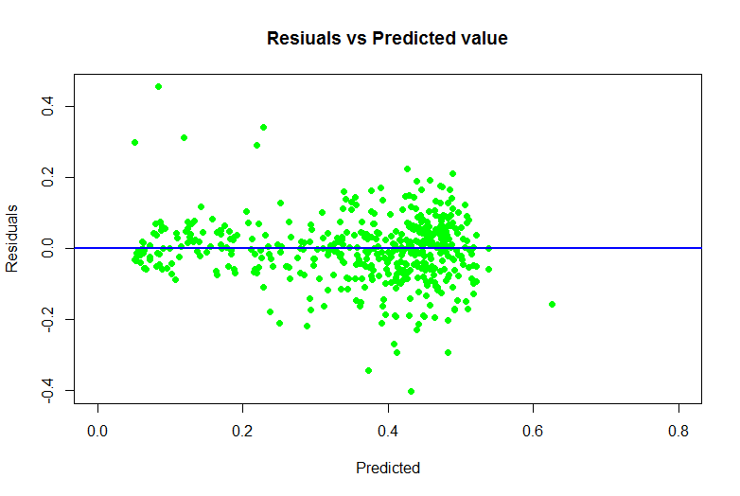
Modelling – Artificial Neural Network
RMSE | 9%
MAE | 6%

Slide 29
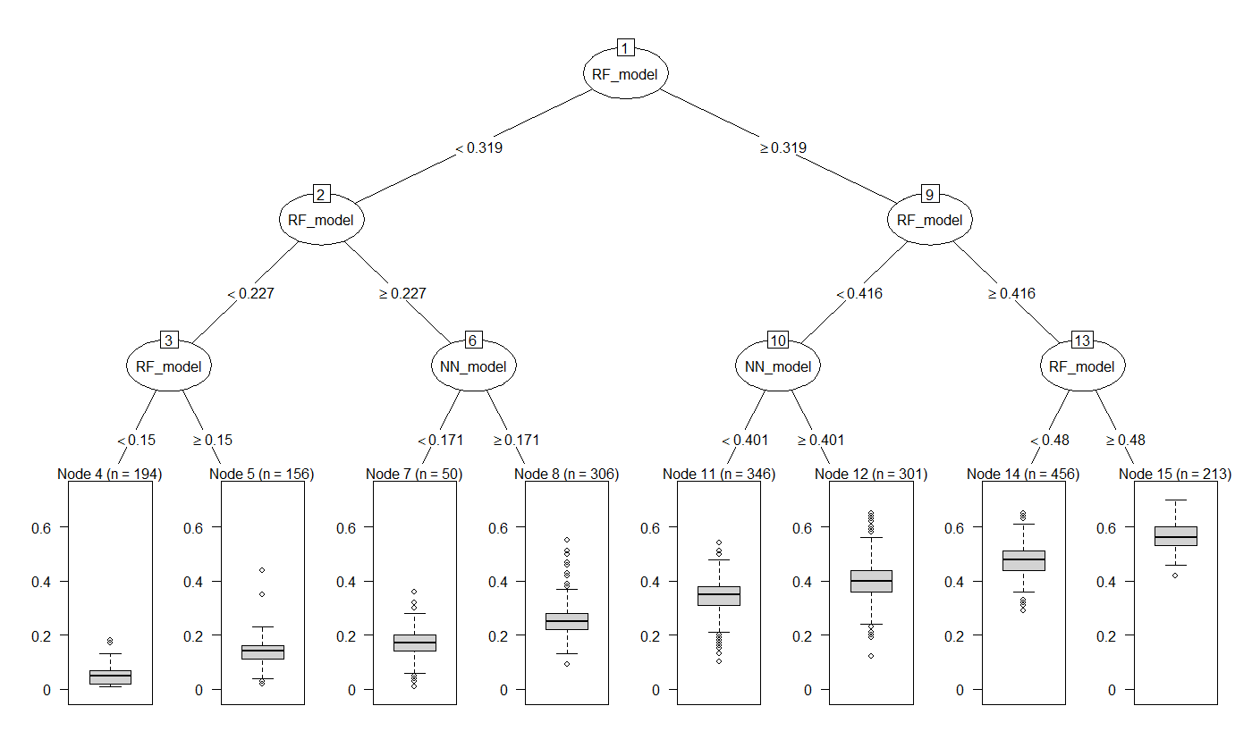
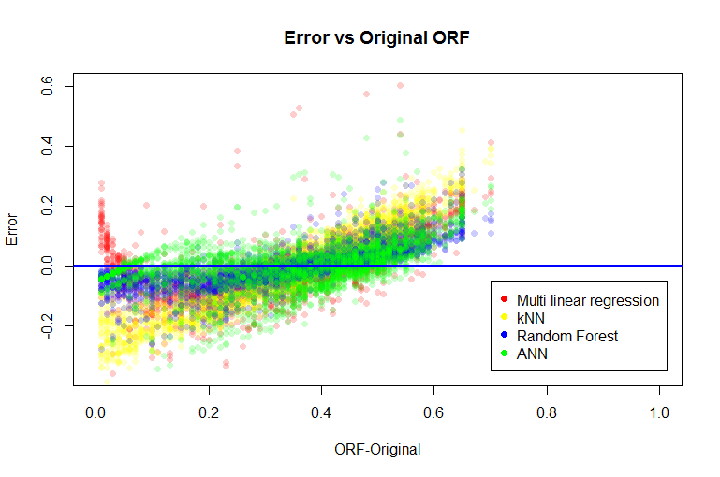
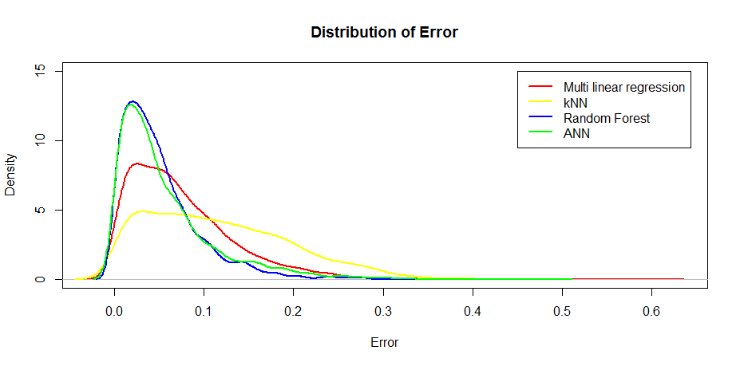
Ensemble modelling
Notes:
MLR poor low ORF
RF better than ANN at high ORF

Slide 30
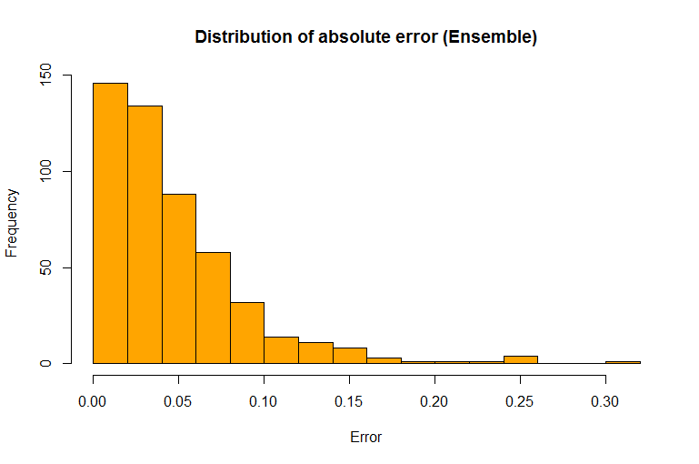
Ensemble modelling
RMSE | 6.3%
MAE | 4.6%

Slide 31
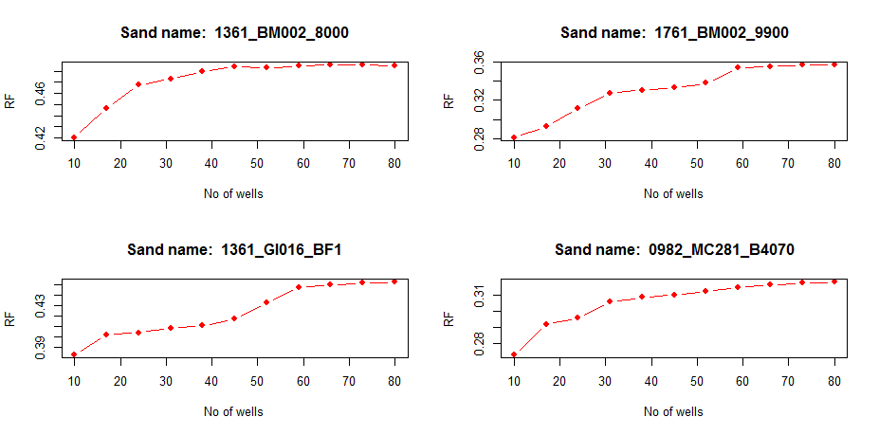
Sensitivity Analysis- No of wells

Slide 32
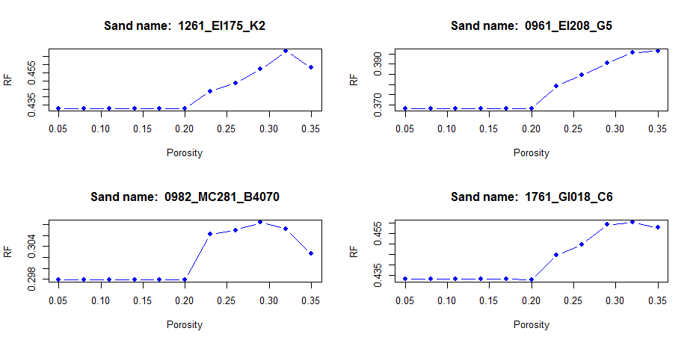
Sensitivity Analysis- Porosity

Slide 33
Discussion
Model | RMSE | MAE | Remarks
Multiple linear Regression | 9.0% | 7.0% | No restriction on predicting negative ORF
Robust linear Regression | 9.3% | 7.2% | Poor performance at extremes
LASSO | 11.0% | 9.5% | Can select top predictors and ignore irrelevant predictors
Regression Tree | 13% | 10% | Model non linear interactions upto limited extent
Random Forest | 11.1% | 9.0% | No absurd predictions Black box model
Artificial Neural Network | 8.5% | 6.0% | Automatically simulates non linear interactions. Black box model
Ensemble Model | 6.3% | 4.6% | Combines strengths of above models

Slide 34
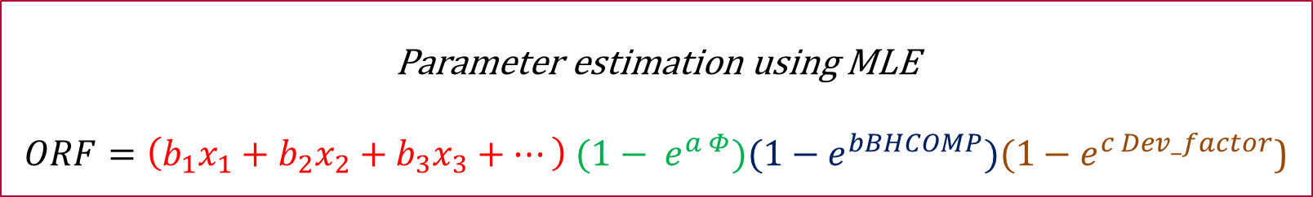
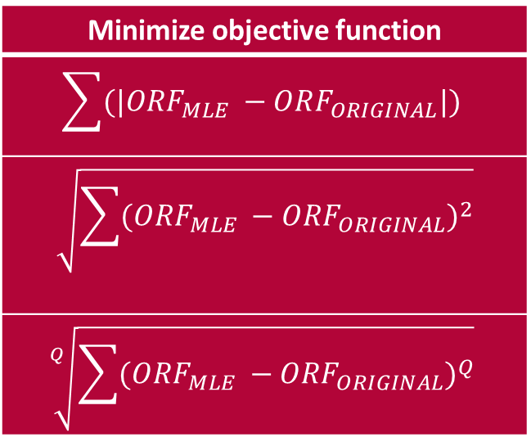
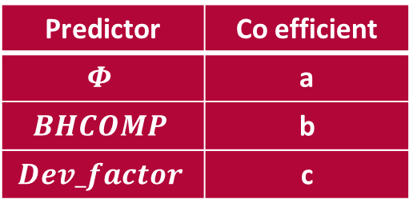
Recommendation for further work
Minimize objective function
$$\sum{(|ORF_{MLE} −ORF_{ORIGINAL}|)}$$
$$\sqrt{\sum{{(ORF_{MLE} −ORF_{ORIGINAL})}^{2}}}$$
$$\sqrt[Q]{\sum{{(ORF_{MLE} −ORF_{ORIGINAL})}^{Q}}}$$
Predictor | Co efficient
$$Φ$$ | a
$$BHCOMP$$ | b
$$Dev_factor$$ | c
Parameter estimation using MLE
$ORF=\left(b_{1}x_{1}+b_{2}x_{2}+b_{3}x_{3}+…\right) (1− e^{a Φ})(1−e^{bBHCOMP})(1−e^{c Dev_factor}$)

Slide 35
Conclusions
Dimensionless numbers can be used to scale data analytical models to predict Ultimate recovery factor and Reservoir performance. They makes the model applicable to new data and also to reservoirs out of study area.
There is always compromise between complexity of the model and interpretability. Multiple linear regression model could be easily interpreted, but cannot model non linear interactions implicitly. Regression trees can model non linear interactions only up to limited extent. ANN model acts like a black box but can model non linear interactions implicitly
Models using parameter estimation with MLE can connect physics and mathematics in a better way.

Slide 36
Thank You

Slide 37
Back up

Slide 38

Regression trees – Variable Importance
Pros
Easy to interpret and understand
No pre processing of the data
Robust to outliers
Importance of predictors
Cons
High bias
Stability

Slide 39

Modelling- k Nearest Neighbours
Identifies nearest neighbors based on distance metric
Target variable – summary statistic of nearest neighbors
Scaling and centering predictors
Method | Distance Expression
Euclidean distance | $$\sqrt{\sum_{j=1}^{P}{{(x_{aj}−x_{bj})}^{2}}}$$
Murkowski distance | $$\sqrt[q]{\sum_{j=1}^{P}{{\left|x_{aj}−x_{bj}\right|}^{q}}}$$
Manhattan distance | $$\sum_{j=1}^{P}{|x_{aj}−x_{bj}|}$$
Euclidean distance is used in the model

Slide 40
Modelling- k Nearest Neighbours
Optimum number of neighbors - 10
No negative ORF predicted
Missed trend due to the presence of complex relationships between predictors.
RMSE | 12.8%
MAE | 10.5%

Slide 41



Slide 42

Data sets for different models
Outliers
Data set | Dimensions | Modelling Techniques
GoM_Original | 2524 x 18 | Decision Tree, Random Forest
GoM_processed | 2514 x 33 | Linear Regression Variants, ANN
GoM_proc_nooutliers | 2423 x 33 | Linear Regression Variants, ANN

Slide 43


Slide 44


Slide 45





Slide 46
[1] "FSTRU.A" "FSTRU.B" "FSTRU.C" "FSTRU.D"
[5] "FSTRU.E" "FSTRU.K" "PLAY_TYPE.A1" "PLAY_TYPE.F1"
[9] "PLAY_TYPE.F2" "PLAY_TYPE.P1" "CHRONOZONE2.MIOCENE" "CHRONOZONE2.PLEISTOCENE"
[13] "CHRONOZONE2.PLIO_UPR" "DRIVE.COM" "DRIVE.DEP" "DRIVE.PAR"
[17] "DRIVE.WTR" "RES_TYPE.N" "RES_TYPE.S" "RES_TYPE.U"
[21] "POROSITY" "SW" "BHCOMP" "Mobility_Ratio_endpoint"
[25] "Nalpha" "Np" "Ng" "Npc"
[29] "Dev_factor" "Hetro_factor" "ORF"

Slide 47
FSTRU | Dip Angle
A / Anticline | 10
B / Fault | 11
C / Sallow Salt diapir | 12
D / Intermediate Salt diapir | 13
E / Deep Salt dome | 14
F / Salt Ridge | 15
G/ Shale diapir | 16
H/ Unconformity | 17
I/ Stratigraphic | 18
J/ Reef | 19

